Slide 1
PALLE SRUJANA
(Implies Village creativity)
Started in November 2005
A Volunteer group
Nurtures Grassroots creativity to provide Affordable solutions to villagers

Slide 2
Practically speaking
“Purpose of life is to ensure Happiness in and around us”
The Dalai Lama Said
“The Purpose of Life is to be Happy

Slide 3
Evolve Ideas which make life Better for everyone
Reduce Pain and Enhance Happiness

Slide 4
Path to World Peace
Knowledge
Creativity
Innovation
Reduced Pain
Happiness
PEACE

Slide 5
Innovation Eco System of A Nation
Public Innovations: CSIR, ICMR, ICAR, DRDO, ISRO, BARC, IITs, NITs etc
Private Innovations: L&T, TCS, Godrej, Mahindra, etc
School Innovations: Children and Teachers (26 Crores)
Grassroots Innovations: Farmers, Youth, children and women. Innovations are affordable and appropriate.

Slide 6
Grassroots Innovations
Attributes
Rebels of the order
Experiment to build their capacity
Samvedana based solutions
Emerged out of the urge to solve their problems.
Frugal, unengineered, and made with local material.
User friendly, easily affordable and impacts millions
Appropriate and affordable (Low Cost0
Protection of IPR is to be ensured

Slide 7
People on the Margin need not possess marginal minds
Poor have head and they are creative too
Palle Srujana respects villagers
Villages are Source and not Sinks

Slide 8
Gandhian Engineering
Reiterated by Dr R A Mashelkar
Principle of MLM
More from Less
For Many
Leading to
Affordability, Availability,
Acceptability and Accessibility

Slide 9
Palle Srujana Philosophy
Reciprocal, responsible and mutually respectful knowledge exchange

Slide 10
Palle Srujana
Our approach is to believe in the creativity of common people
Our work force is volunteers from all segments of society
Our resource is the goodness of people
Our accountability is to Grassroots innovators
Our dream is to bring equity and sustainability
Our philosophy is “Samvedana”
No Resources, No organization, No authority, No targets, No disappointments, No failures, ……………….
Only success- however small it is

Slide 11
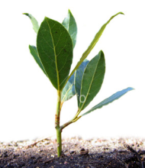



What we do for Grassroots Innovations (GRI)?
Patenting
}
Scouting
Documenting
Prototyping, Value Addition,
Validation, Reengineering
Recognition
& Awards
Activity
Scouting &Documentation
Value Addition
Patent
Dissemination
Awards and recognition
Connectivity with formal system
Connecting school and college students
Business Development

Slide 12
Impact of Grassroots Innovations on Society
Provide low cost solutions in livelihood sector such as weeders, cultivators, seeders, sprayers, seeds, bio-pesticides, animal medicines etc.
Affordability ensures availability .
Appropriateness results in sustainability.
Adhere to the Principle of “More from Less for Many”.
Reduced input costs .
Local employment.
Lesser cost of development.
Local Wealth creation and distribution.
Inclusiveness in real sense and Knowledge based society.
Pochampalli Tradition survived due to Asu machine by providing livelihood to thousands of weaver families.

Slide 13
Self reliance
GRI have all the following attributes which are SDG
Empowerment
Grassroots
Social benefit
Entrepreneurship
Sustainability
Wealth Creation

Slide 14
These innovations are too promising to ignore

Slide 15
How do we disseminate the Grassroots knowledge
Periodical publication of Magazines in many languages
Shodha Yatras and Chinna Shodha Yatras – every quarter
Innovation Diffusion Centre (IDC) @ Hyderabad
Exhibitions at National, state, district and Mandal level
Interacting with formal system at various levels
Websites
Participating in National and International awards
Communicating with Formal Institutions and organizations etc.
Weekly webinars on Innovations. 40 conducted so far.

Slide 16
Display of Grassroots Innovations
For masses
in villages, mandals and districts
In cultural and religious events
For students and faculty in colleges
For entrepreneurs ,investors, scientists, and professionals in
  NIRD, T HUB, Innofest, Makers Faire, Tedx platform, CII, NIF, Agri Universities, Technology fairs, IIIF, IIFS, Science fairs, etc.
  Digital and print media will be present at all the above places.

Slide 17
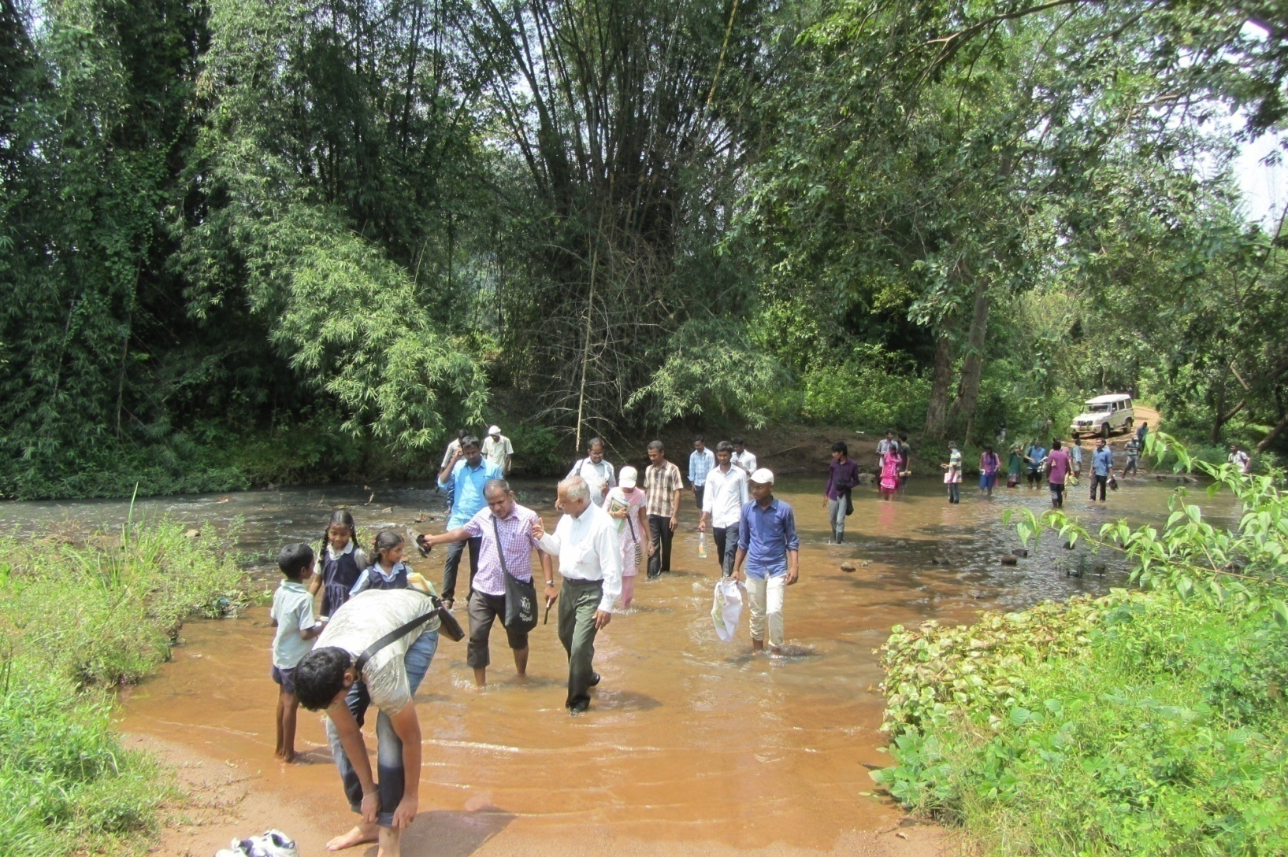
Shodha Yatra
A pilgrimage to the forgotten Temples of Knowledge
Experience an unknown area, unknown context, unknown people and unknown agenda

Slide 18
Shodh yatra
Education beyond walls
An unknown journey
in an unknown context
in an unknown path
to interact with unknown people
with an unknown agenda
Unlearn and Relearn from four Teachers
        Teacher in Nature
        Teacher in people
        Teacher in peers
        Teacher within you

Slide 19
Chinna Sodha Yatra (CSY)
A pilgrimage to the temples of Knowledge - villages
Unlearn and relearn
A walk in an Unknown path, Unknown people, with Unknown agenda for 55-60 Kms in three days every quarter.
38 Yatras, around 1500 kms, over 900 participants, visited 600 villages, interacted with over 50,000 rural people, Scouted and disseminated many grassroots innovations.
Next Yatra in December 2021
Visit www.pallesrujana.org for more details

Slide 20
Webinar on Innovations
A Reaction to Pandemic
Every week commencing from October 2020
47 Webinars
93 Innovators
174 Innovations
48 Guest Speakers
Over 1000 Participants
Period: 14th October, 2020 to 07 October, 2021

Slide 21
Recognition to GRI from AP and TS
Three PADMASHRI awards
13 President of India awards
2 National Entrepreneur awards
First Prize in ASEAN Innovation Festival, 2019
Two International awards 2020
2 NABARD awards
Two Samsung Innovation Quotient Awards
One Hony Doctorate
One in Forbes – MIT US List
Hall of Fame – Civil Society -Two Innovators
Ten Raitu Nestam awards
Many local and Regional awards
INK Fellow – Los Angeles
TEDx lectures
Six NIRD&PR awards
One Biopic on innovator Mallesham
Supply of over 1300 Laxmi Asu Machines to Pochampally weavers

Slide 22
Palle Srujana Initiatives
Chinna Shodha Yatra
Rural Internship - TISS, NAARM, IITs, Engg and Management Colleges
Gram Swayam Samruddhi
Rural Connect all college students
Certification to Herbal healers in collaboration with TDU, Benagluru
Gyan Shodh
Identify Problems from Livelihoods of villages –farming, weaving, Fishing etc, and Provide solutions

Slide 23
Ground covered in Two Telugu States by Palle Srujana
Scouted over 400 innovations, 50 plus best farm practices.
Documented 2000 plus traditional knowledge in 12 years
34 Patents
0ver 80 Innovations in market.
Over 200 direct employment.
Annual turn over of grassroots innovations is over Rs 6 crores
during 2019-20.
Impacted estimated 8 Lakh rural families over the years
Publication of Telugu bi-monthly “Palle Srujana” since May 2006 – uninterrupted 82 issues.
Horizontal dissemination of knowledge gathering momentum steadily
Many International, National and Regional awards including:
one ASEAN first prize, Two Padmashri, Forbes list, TEDx lectures, INK Fellow, President of India awards to Innovators and School children.

Slide 24
Impact of Grassroots Innovations on Society
Provide low cost solutions in livelihood sector such as weeders, cultivators, seeders, sprayers, seeds, bio-pesticides, animal medicines etc.
Affordability ensures availability .
Appropriateness results in sustainability.
Adhere to the Principle of “More from Less for Many”.
Reduced input costs .
Local employment.
Lesser cost of development.
Local Wealth distribution.
Inclusiveness in real sense and Knowledge based society.
Pochampalli Tradition survived due to Asu machine by providing livelihood to thousands of weaver families.

Slide 25
Challenges in Nurturing GRI
GRI develops innovation in a hut. Each one is a start up in real sense.
These innovations address unmet needs, hence market is assured.
Reaching geographically wide market is challenging.
Fund support is difficult as the innovator lives in informal sector.
These innovations are people centric hence ,akes less sense to Business.
Mentoring in few technological aspects and legal practices is necessary on case basis.
A new Incubation model to include GRIs in the main stream is necessary.
To unearth more innovations, vigorous scouting, dissemination of “Palle Srujana magazine for all Telugu villages is essential.
Access to International market either by direct selling or Transfer of Technology.

Slide 26
Reverse the Farm Sector Supply Model
Present model
Few supply to billions – Wealth Concentration
New Model
Millions make and supply to billions
Wealth Distribution
Promote entrepreneurs at grassroots level

Slide 27
Dreams of Palle Srujana
To make our villages
Regain their Samruddhi status
Atma Nirbhar (Self Sufficient)
Leverage and sustain regeneration of Nature
Low cost and affordable tools and devices but provide high productivity
Least environmental degradation
More Exports and least Imports in each village
Live healthy and let others live same way
Inclusiveness and equity
A Happy Telangana
This is not an Utopian dream. It is achievable.
We believe in it. Do You?

Slide 28
Path Ahead
When you can not remove the problem…
Reduce the pain
Each one of us has some capacity
to reduce the pain
Let us do it
Palle Srujana does ..

Slide 29
Palle Srujana wishes you the Best
Thanks so Much
Brig P Ganesham, VSM (Retd)
Founder President, Palle Srujana
ww.pallesrujana.org
president@pallesrujana.org
9866001678

