Slide 1
PALLE SRUJANA
(Implies Village creativity)
A Volunteer group
Nurtures Grassroots creativity to provide Affordable solutions to villagers
www.pallesrujana.org
president@pallesrujana.org
9866001678

Slide 2
About us
Voluntary core group of six senior citizens from different walks of life.
Over 5000 volunteers from AP and TS.
Admirers and supporters in Govt, Private Institutions and individuals, Print and electronic media, social networks.
Good relations with corporate
Collaboration with NAARM, ASCI, TISS, NITs, IITs, ALC, CIPS, TSIC, J2IC,
MoU with many Engineering and Management Institutions for rural connectivity and Internship

Slide 3
People on the Margin need not possess marginal minds
Poor have head and they are creative too

Slide 4




What we do for Grassroots Innovations (GRI)?
Patenting
}
Scouting
Documenting
Prototyping, Value Addition,
Validation, Reengineering
Recognition
& Awards
Activity
Scouting &Documentation
Value Addition
Patent
Dissemination
Awards and recognition
Connectivity
Business Development

Slide 5
Primary Activity
Palle Srujana
Scouting & Documentation
Value Addition
Patenting and Recognition
Dissemination
Connectivity with formal system
Schools and Colleges – Interaction and Internship
Related to Grassroots creativity and Traditional knowledge

Slide 6
Ground covered in Two Telugu States by
Palle Srujana since 2005
Scouted over 200 innovations, 50 plus best farm practices.
Documented 2000 plus traditional knowledge in 12 years
23 Patents for grassroots innovations
0ver 40 Innovations in market.
Over 200 direct employment.
Annual turn over of grassroots innovations is over Rs 5 Crores.
during 2019-20.
Impacted estimated 5 Lakh rural families over the years
33 Chinna Shodha Yatras – visited over 500 villages, interacted with over 35000 farmers, walked 1500 kms and more…
73 uninterrupted publication of “Telugu bi-monthly – PalleSrujanasince 2006.
Participated in over 200 exhibitions across the country displaying innovations and connecting innovators to the system.
Horizontal dissemination of knowledge gathering momentum steadily
Many International, National and Regional awards including
one ASEAN first prize, Three Padmashri, Forbes list, TEDx lectures, INK Fellow, President of India awards to Innovators and to School children.

Slide 7
Recognition to GRI from AP and TS
Efforts of Volunteers
Three PADMASRI
One Honorary Doctorate
13 President of India awards
One Amazing Indian awarded by the Prime Minister
Two NABARD awards
8 NIRD awards
Two Samsung Innovation Quotient Awards
One in Forbes – MIT US List
Hall of Fame – Civil Society for Two Innovators
Many local and regional awards
INK Fellow – Los Angeles
Two in TEDx lectures
Two National Entrepreneur awards
One ASEAN Innovation First Prize
34 President awards to school children

Slide 8
Impact of Grassroots Innovations on Society
Provide low cost solutions in livelihood sector such as weeders, cultivators, seeders, sprayers, seeds, biopesticides, animal medicines etc.
Affordability ensures availability .
Appropriateness results in sustainability.
Adhere to the Principle of “More from Less for Many”.
Ensure “Affordable excellence”
Reduced input costs.
Local employment.
Lesser cost of development.
Local Wealth distribution.
Inclusiveness in real sense.
Knowledge based society.
Pochampalli Tradition survived due to Asu machine by providing livelihood to thousands of weaver families.

Slide 9
Challenges in Nurturing GRI
GRI develops innovation in a hut. Each one is a start up in real sense.
These innovations address unmet needs, hence market is assured.
Reaching geographically wide market is challenging.
Fund support is difficult as the innovator lives in informal sector.
These innovations are people centric.
Mentoring in few technological aspects and legal practices is necessary on case basis.
A new Incubation model to include GRIs in the main stream is necessary.
To unearth more innovations, vigorous scouting, dissemination of “Palle Srujana” magazine for all Telugu villages is essential.
Access to International market either by direct selling or Transfer of Technology.
Palle Srujana with its over 1000 volunteers invites JICA to pitch in for GRIs of Telangana

Slide 10

Honeybee Network
Virtual and Voluntary
A nameless, faceless innovator or a
traditional knowledge holder comes in contact with
Honeybee network and gets an identity

Slide 11
How do we disseminate the Grassroots knowledge
Palle Srujana Magazine
Chinna Shodha Yatra
Innovation Diffusion Centre (IDC)
Exhibitions at National, district and Mandal level
Talking to college Faculty and students
Website www.pallesrujana.org
Participating in National and International awards

Slide 12

Palle Srujana Magazine

Slide 13
Innovation Diffusion Centres(IDC)
Hyderabad and Vijayawada
Children, Engineers and Farmers parents, social activists, Govt and private industry are welcome to visit IDC at Palle Srujana office
You can see the innovations and feel them. Many videos are available
Lot of information can be shared with Palle Srujana team
Select products for entrepreneurship
You can read all 53 issues of Palle Srujana
Reach IDC @ 040 27111959
Address: 77, Road no 3, Vayupuri, Post Sainikpuri, Secunderabad – 500094
Tickle Road, Vijayawada

Slide 14
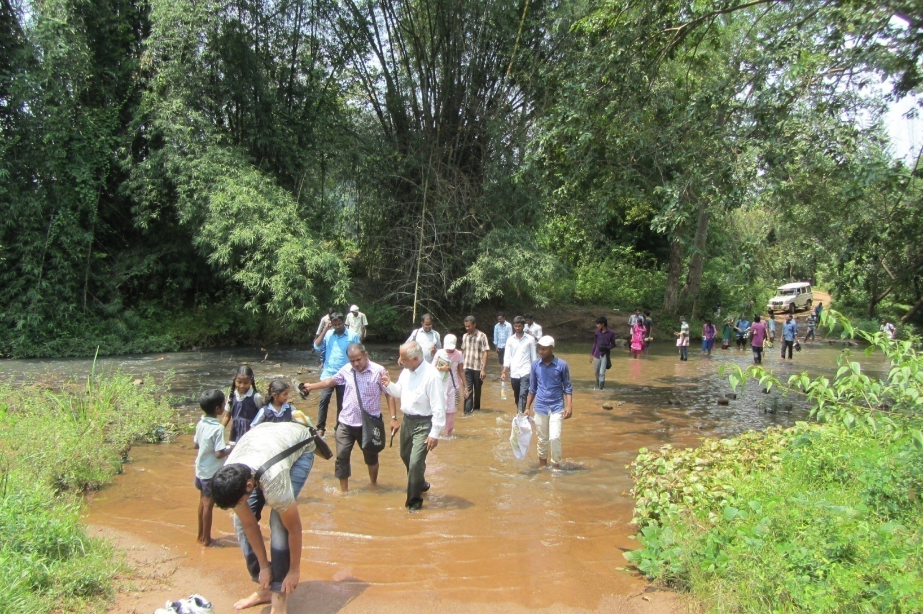
Shodha Yatra
A pilgrimage to the forgotten Temples of Knowledge
Experience an unknown area, unknown context, unknown people and unknown agenda

Slide 15
Shodh yatra
Education beyond walls
Unlearn and Relearn from four Teachers
Teacher in Nature
Teacher in people
Teacher in peers
Teacher within you
Shodh yatra is held every quarter in different
parts of the country.
For Details visit www.sristi.org

Slide 16
Chinna Sodha Yatra (CSY)
A pilgrimage to the temples of Knowledge
33 Yatras, more than 1500 kms, over 1000 participants, visited 500 villages, interacted with 50,000 rural people, Scouted and disseminated many grassroots innovations.
Next Yatra in February 2020.
Every yatra is for 3 days. Register on line
Visit www.pallesrujana.org for more details

Slide 17
What Palle Srujana offers?
Volunteerism
Internship

Slide 18
Activity for Volunteers
Scouting – Virtual and Physical
Translating Palle Srujana articles into English
Increasing the subscription base of Palle Srujana magazine
Connecting colleges
Capturing ideas from school children – for Ignite 2017, MANAK and through Science express
Exhibitions for display of Grassroots innovations
Crazy Innovations – Incubation, Funding etc
Convert NIF Technical database into Telugu
Prepare Technology documentation
Nominate Grassroots innovators for awards –Regional, National and International
Write stories of Innovators in English and Telugu

Slide 19
Activity for Interns
Discussion with President
Firm up the schedule
Visit 2-3 Innovators in their villages
Prepare Technology documentation
Translate 10 Technologies from NIF website
Translate articles from Palle Srujana to English
Reengineer innovations
Participate in Chinna shodha yatra
Demonstrate Innovations at IDC
Prepare a video sequel of innovations for display at IDC
Nominate Grassroots innovators for awards –Regional, National and International
Write impressions and takeaways from Internship

Slide 20
What You can do?
Speak about grassroots innovations (GRI) in your community.
Respect people in the informal sector for their creativity and traditional knowledge.
Visit Innovators.
Organize display and demonstration of GRIs for farmers, school children and college students.
Involve in scouting and dissemination.
Identify Unmet needs of the society.
Join Shodha yatra.
Upload your projects to www.techpedia.in
Undertake original problems for projects.
Form NIF clubs.
Connect entrepreneurs for marketing Innovations.
Influence policy to incorporate GRIs.
Become a Social Entrepreneur and market the GRI.

Slide 21
Palle Srujana
Our approach is to believe in the creativity of common people
Our work force is volunteers from all segments of society
Our resource is the goodness of people
Our accountability is to Grassroots innovators
Our dream is to bring equity and sustainability
Our philosophy is “Samvedana”
No Resources, No organization, No authority, No targets, No disappointments, No failures, ……………….
Only success- however small it is
Jaihind

Slide 22
Way Ahead
Intensify scouting. Starting from district and then to mandal/block level.
Establish GRIPS – Grassroots innovation Promotion Scheme, for AP and TS with support from Govt /private organizations.
Palle Srujana magazine should reach every Telugu village and publish every month.
Provide platform for Internship to College students for working in the Rural areas.
Promote hand tools manufacturing and supply to remote villages.
Certification for herbal healers to preserve the paramparic gyan.

Slide 23
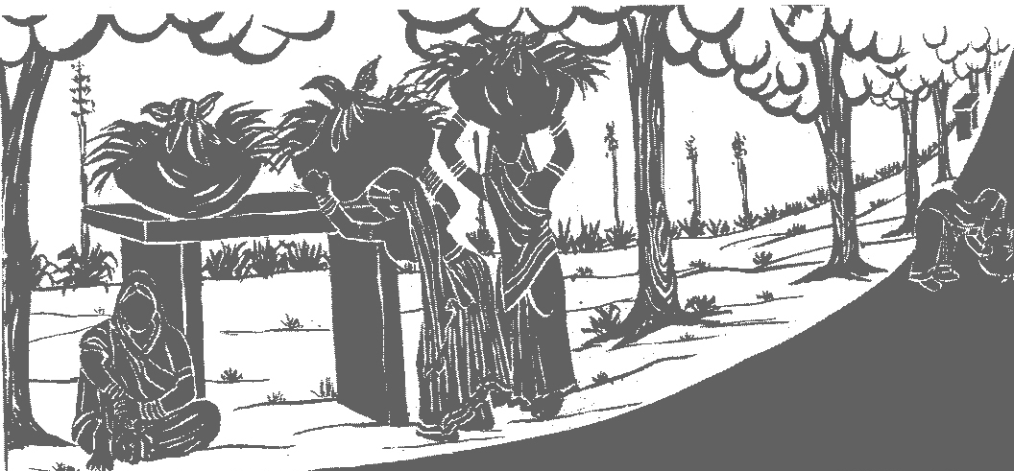
Gondal king, 1890s, Gujarat

Slide 24
When you can not remove the problem…
Reduce the pain
Each one of us has some capacity to reduce the pain.
Let us do it………………..

Slide 25
Thanks so much

